Slide 1

STRATEGIC INTELLIGENCE 2026
Data Analytics: Unlocking Insights
Transforming raw data into strategic assets through advanced examination, visualization, and predictive modeling.

Slide 2

The Core Foundation
Defining the parameters of the modern data landscape.

Slide 3
What is Data Analytics?
Scientific Examination: The process of inspecting and modeling data with the goal of discovering useful information.
Informed Decision Making: Moving away from intuition-based choices toward evidence-based business strategies.
Trend Discovery: Identifying patterns and correlations within large datasets that are otherwise invisible.
Risk Mitigation: Using historical data to predict potential pitfalls and secure business operations.

Slide 4


The Four Main Pillars
Descriptive
Diagnostic
"What happened?". Checking old records to see what happened in the past
"Why did it happen?". Looking at past records to see how the whole company has been doing.
Predictive
Prescriptive
"What might happen?" Using statistical models and machine learning to forecast future trends and probabilities.
"How can we make it happen?" Recommending specific actions based on predictions to achieve the best possible outcome.

Slide 5
The Data Analytics Journey
Cleaning
Visualization
Preparing raw data by removing errors and inconsistencies.
Creating dashboards to communicate findings effectively.
Data Ingestion
Analysis
Collecting data from various internal and external sources.
Applying algorithms to extract meaningful patterns.

Slide 6
Process & Technology
The tools and techniques that power modern intelligence.

Slide 7


Data Cleaning: The Foundation
The most time-consuming yet critical phase of the analytics lifecycle. High-quality output requires high-quality input.
Removing duplicate or irrelevant observations.
Handling missing data through imputation.
Standardizing formats across different sources.

Slide 8






The Modern Tech Stack
Python / R
SQL
BI Tools
The primary languages for statistical modeling, automation, and advanced machine learning libraries.
The universal language for querying, managing, and structuring relational database systems.
Platforms like Tableau and Power BI that turn complex data into interactive visual stories.

Slide 9
Impact & Innovation
Exploring real-world value and advanced AI horizons.

Slide 10
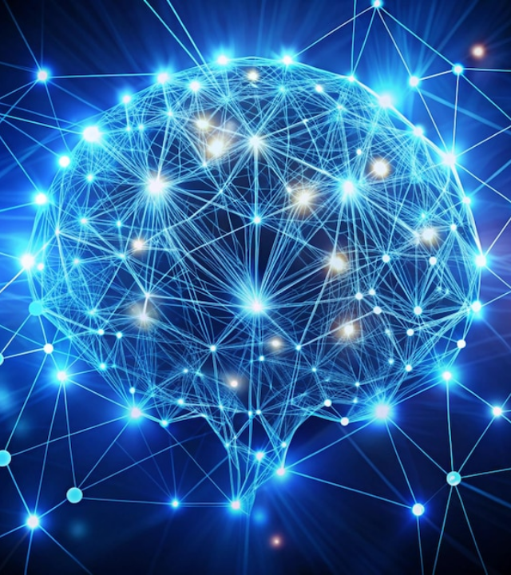
AI & Predictive Frontiers
Artificial Intelligence is no longer a luxury but a core component of modern data strategy.
By leveraging neural networks and deep learning, organizations can move beyond simple trends to autonomous prescriptive systems that optimize logistics in real-time.

Slide 11




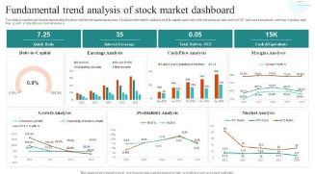

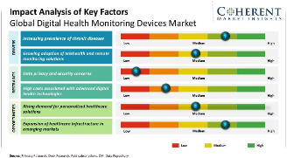


Industry-Specific Applications
Financial Services
Healthcare
Modern Retail
Fraud detection and algorithmic trading based on market volatility.
Predictive patient outcomes and personalized medicine pathways.
Demand forecasting and highly targeted customer segmentation.

Slide 12
The Business ROI
Tangible Value Gains
85%
Data-driven organizations are significantly more likely to acquire customers and remain profitable.
23x more likely to acquire customers.
Of CEOs see data as a strategic asset
6x more likely to retain customers.
19x more likely to be profitable.

Slide 13
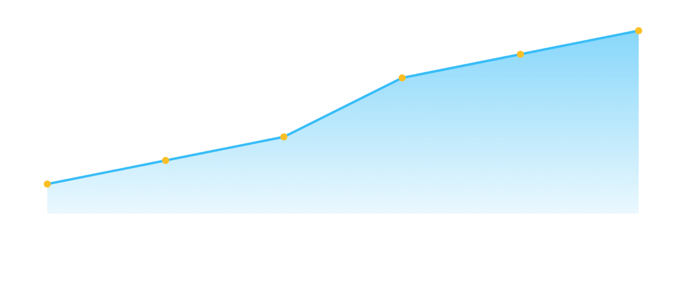
Market Growth Trends
2021 (Base)20222023202420252026 (Forecast)
Projected 25% CAGR in global Big Data and Analytics software spending.

Slide 14
Governance & Ethics
Core Principle | Business Priority | Risk Level
Data Privacy | Compliance with GDPR/CCPA regulations. | High
Algorithmic Bias | Ensuring fairness in automated decisions. | Medium
Data Sovereignty | Control over where data is stored/processed. | Medium
Transparency | Ability to explain AI-driven outcomes. | Low

Slide 15


Future: Edge & Real-time
Hyper-Connectivity
Data analytics is moving closer to the source (The Edge). Instead of processing everything in the cloud, future systems will make split-second decisions locally—powering autonomous vehicles and smart cities.
The integration of IoT and 5G will enable truly real-time prescriptive analytics at a global scale.

Slide 16
CONCLUSION
Any Questions?
strategic.analytics@example.com
www.analytics-future.com

Slide 17






Image Sources
https://media.istockphoto.com/id/2230014057/photo/close-up-of-typescript-code-defining-interfaces-for-product-and-category-data-structures.jpg?s=612x612&w=is&k=20&c=GiBw8We88aI-IRuh60U465pAcKYwA9GSaVnCzyZAE9k=
Source: www.istockphoto.com
https://img.freepik.com/premium-photo/abstract-image-neural-connections-blue-background-technological-background-design-theme-artificial-intelligence-big-date-neural-connections_1028938-510080.jpg
Source: www.freepik.com
https://www.slidegeeks.com/media/catalog/product/cache/560x315/F/u/Fundamental_Trend_Analysis_Of_Stock_Market_Dashboard_Professional_PDF_Slide_1_1.jpg
Source: www.slidegeeks.com
https://www.coherentmarketinsights.com/images/research-%20methodology/digital-health-monitoring-devices-market-key-factors.webp
Source: www.coherentmarketinsights.com
https://mi9retail.com/wp-content/uploads/2025/12/Wordpress-Feature-Image-11.png
Source: mi9retail.com
https://png.pngtree.com/thumb_back/fw800/background/20251225/pngtree-futuristic-holographic-display-with-data-visualization-in-a-modern-presentation-room-image_20909826.webp
Source: pngtree.com

